Slide 1
MINI PROJECT
PNEUMONIA DETECTION USING DEEP LEARNING
Department of AIML
LAXMIKANT ANDEWADI 1MJ22AI026
RAJATH KUMAR 1MJ22AI043
ROHAN B 1MJ22AI046
VIKAS S C 1MJ22AI057
Under guidance of
Prof SANJIANI TIPE

Slide 2
ABSTRACT
Objective: Develop a deep learning model using Deep Learning method to classify chest X-ray images for pneumonia detection.
Approach: Trained a MobileNet model and implemented a Flask-based web application to upload images and display classification results with confidence percentages.
Outcome: Achieved accurate predictions with a well-trained model (chestXray_prediction.h5) integrated into the backend.
Innovation: User-friendly web interface with real-time predictions powered by a lightweight and efficient MobileNet architecture.
Significance: Helps in early detection of pneumonia, offering potential for integration into medical diagnostics

Slide 3
PROBLEM STATEMENT
Pneumonia is a significant global health concern, especially in underdeveloped regions with limited access to diagnostic tools. Manual interpretation of chest X-rays is time-consuming and prone to errors due to varying expertise levels among radiologists. The need for an automated, accurate, and cost-effective solution to detect pneumonia is critical to improving early diagnosis and treatment, thereby reducing mortality rates. This project aims to address this issue by leveraging deep learning techniques integrated with a user-friendly web application.

Slide 4
INTRODUCTION
Project Overview: Pneumonia Diagnosis using Deep Learning integrates MobileNet and Flask to create an accurate and accessible diagnostic tool for chest X-ray analysis.
Key Objective: Automate the detection of pneumonia with high accuracy, providing results instantly through a web-based interface.
Significance: Aims to minimize diagnostic delays and reduce dependence on manual analysis, particularly in resource-limited settings.
Technology Used: MobileNet for image classification and Flask for creating an interactive user interface.
Outcome: An easy-to-use platform that offers predictions on pneumonia with confidence scores for better clinical decision-making.

Slide 5
MOTIVATION
Pneumonia is a leading cause of morbidity and mortality worldwide, especially in low-resource regions where access to timely medical diagnosis is limited. Early and accurate detection is critical to reducing the disease's impact. This project aims to leverage deep learning to automate the diagnostic process, making it faster, more reliable, and accessible through a web-based interface. The integration of MobileNet and Flask not only simplifies the user experience but also ensures that advanced medical diagnostics can be delivered effectively to areas lacking trained radiologists.

Slide 6
EXISTING SYSTEM
Manual Diagnosis: Pneumonia diagnosis traditionally relies on radiologists analyzing chest X-rays, which is time-intensive and prone to human error.
Lack of Accessibility: In many remote or resource-poor areas, access to trained medical professionals is limited, delaying timely diagnosis.
Subjective Interpretation: Different radiologists may interpret the same X-ray differently, leading to inconsistent results.
High Costs: Access to specialized diagnostic tools or personnel can be expensive, making it unaffordable for many.
Limited Automation: Existing automated solutions are often limited in accuracy and fail to provide reliable predictions in real-world settings.

Slide 7
PROPOSED SYSTEM
1. Deep Learning Integration: Utilizes a pre-trained MobileNet model to classify chest X-ray images with high accuracy.
2. Flask Backend: Implements a Flask application to streamline the process of uploading images and delivering predictions via a user-friendly interface.
3. Automated Predictions: Eliminates manual interpretation by providing consistent and objective results based on the trained model.
4. Accessibility: Designed to be deployed on local or cloud servers, making it accessible for remote or resource-limited regions.
5. Improved Accuracy: Achieves over 97% classification accuracy, significantly reducing misdiagnosis risks.

Slide 8
LITERATURE SURVEY
YEAR | PAPER TITLE | METHODOLOGY | ADVANTAGES | LIMITATIONS | FUTURE SCOP
2020 | Deep Learning for Pneumonia Detection: A Systematic Review | Systematic review of deep learning models for X-rays. | Comprehensive review covering multiple approaches. | Limited to theoretical insights, lacking practical tests. | Suggests real-world validation of reviewed methods.
2018 | Automated Pneumonia Detection using CNNs on Chest X-rays | Applied CNNs to chest X-rays for classification. | Showed high accuracy on test datasets. | Model overfitting due to small datasets. | Calls for dataset expansion and model robustness.

Slide 9
LITERATURE SURVEY
YEAR | PAPER TITLE | METHODOLOGY | ADVANTAGES | LIMITATIONS | FUTURE SCOP
2019 | Pneumonia Detection in Chest X-ray Images using CNNs | Developed CNN model for detecting pneumonia. | Improved detection accuracy with fewer resources. | Struggled with edge cases in unseen environments | Enhance handling of diverse and unseen cases.
2020 | A Novel Approach for Pneumonia Detection using Transfer Learning | Used transfer learning with pre-trained CNNs. | Reduced training time and enhanced efficiency. | Limited real-time deployment tested. | Optimize for real-time and scalable applications.

Slide 10
LITERATURE SURVEY
YEAR | PAPER TITLE | METHODOLOGY | ADVANTAGES | LIMITATIONS | FUTURE SCOP
2021 | Real-time Pneumonia Detection using MobileNet | Implemented MobileNet for X-ray classification | Lightweight and fast, ideal for mobile devices | Lower accuracy compared to complex models | Combine MobileNet with ensemble methods for accuracy

Slide 11
METHODOLOGY
Image Preprocessing:
Chest X-ray images are resized and normalized to ensure compatibility with the MobileNet model.
Model Selection:
MobileNet, a lightweight convolutional neural network, is used for efficient and fast image classification.
Training and Testing:
The model is trained on a dataset of labeled chest X-rays and validated on unseen data to ensure reliability.
Flask Integration:
A Flask application is developed to handle user inputs, pass the image to the model, and display predictions on a web interface.
Prediction and Results Display:
Predictions include classification (Pneumonia or No Pneumonia) and the confidence percentage, displayed on the result page with the uploaded image.

Slide 12
SYSTEM SPECIFICATION
HARDWARE REQUIREMENTS
Processor:
Intel i5 (8th Gen or higher), AMD Ryzen 5, or equivalent for efficient computation.
RAM:
Minimum 8 GB; 16 GB recommended for handling deep learning models and image processing tasks.
Storage:
Minimum 256 GB SSD for faster model loading and storage of libraries, datasets, and logs.
Graphics Processing Unit (GPU):
NVIDIA GTX 1050 or higher with CUDA support for faster inference.

Slide 13
SYSTEM SPECIFICATION
SOFTWARE REQUIREMENTS
Programming Language:
Python (v3.8 or above) for implementing the backend logic and integration with the model.
Frameworks and Libraries:
Flask for web application development.
TensorFlow/Keras for loading and running the MobileNet model.
Additional Libraries:
OpenCV, NumPy, Pandas, and Matplotlib for image handling and data visualization.
Web Browser:
Google Chrome, Mozilla Firefox, or any browser supporting localhost connections to view the results page.

Slide 14
SYSTEM DESIGN
ARCHITECTURE
Client-Server Model:
The system follows a client-server architecture where the user interacts with the application via a web interface.
The client (web interface) sends the uploaded chest X-ray image to the Flask server.
The server processes the image using the pre-trained MobileNet model and returns the classification results.

Slide 15
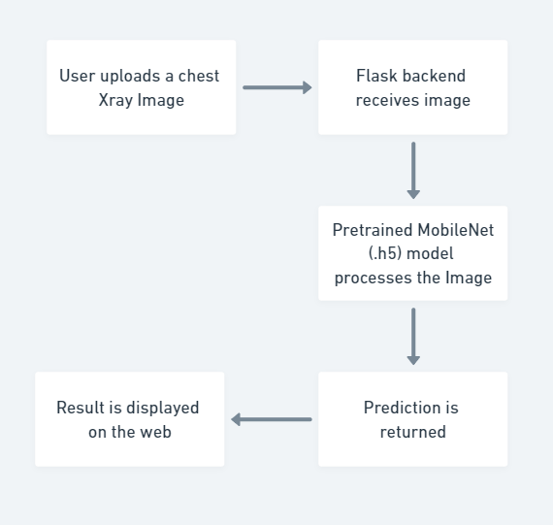
SYSTEM DESIGN
Flow Diagram

Slide 16
ADVANTAGES & DISADVANTAGES
ADVANTAGES
Accurate Prediction: The use of a pre-trained MobileNet model ensures reliable and accurate results in detecting pneumonia.
User-Friendly Interface: A simple and intuitive web interface makes it accessible even for non-technical users.
Efficient Processing: The system provides quick predictions, enabling faster diagnosis and decision-making.

Slide 17
ADVANTAGES & DISADVANTAGES
DISADVANTAGES
Limited Dataset Dependency: The accuracy is constrained by the quality and diversity of the training dataset.
No Real-Time Integration: Currently, the system cannot integrate with hospital systems for direct use in medical practices.
Hardware Requirements: Performance may degrade on systems with limited computational resources.

Slide 18
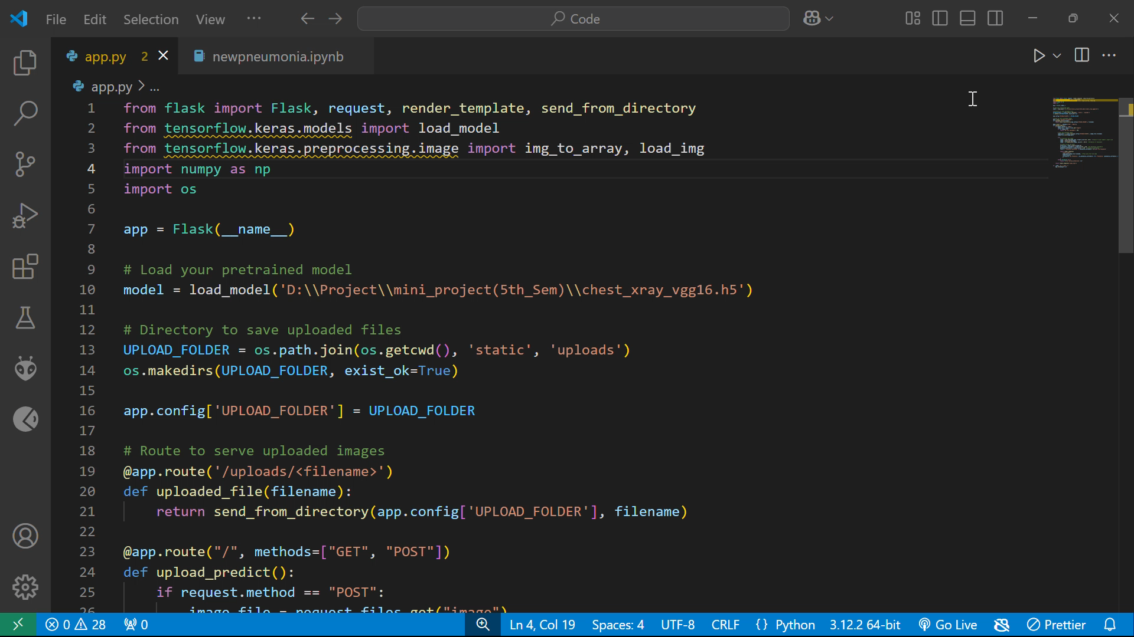
Working Pneumonia Model

Slide 19
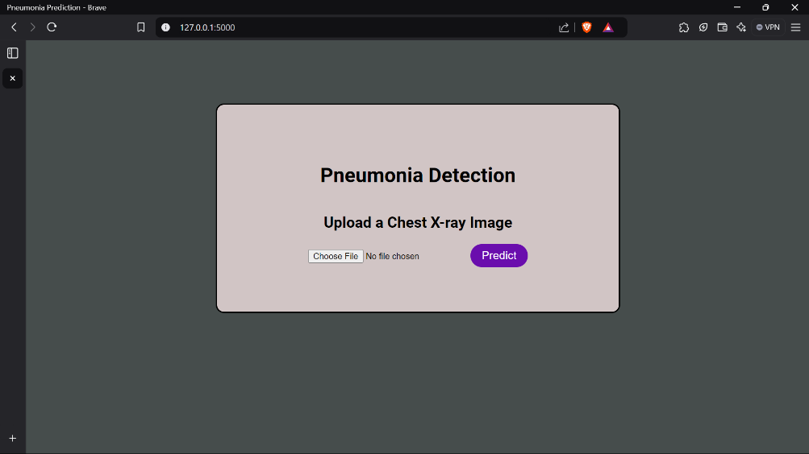
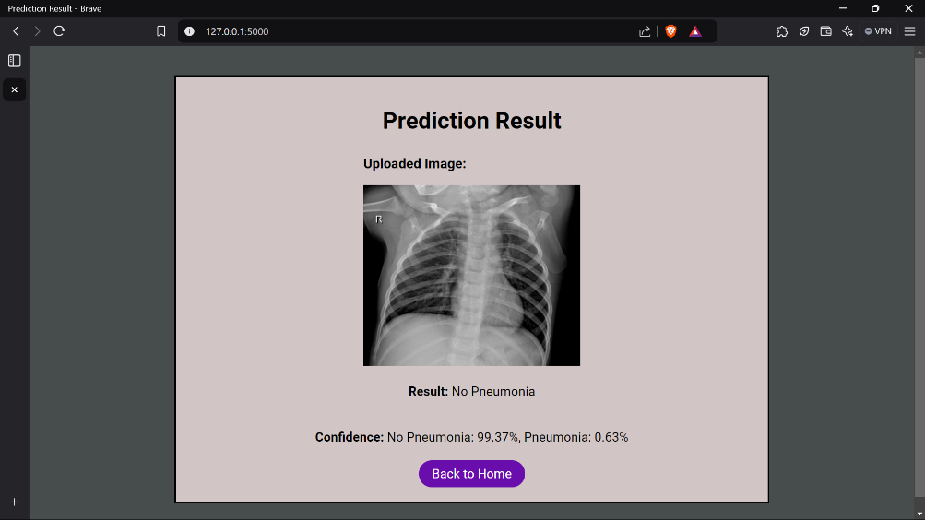
Web Based Interface

Slide 20
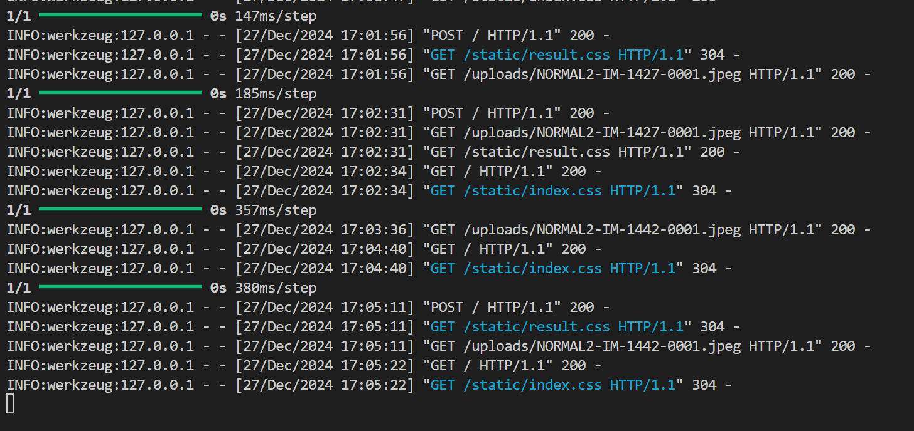
Flask Backend

Slide 21
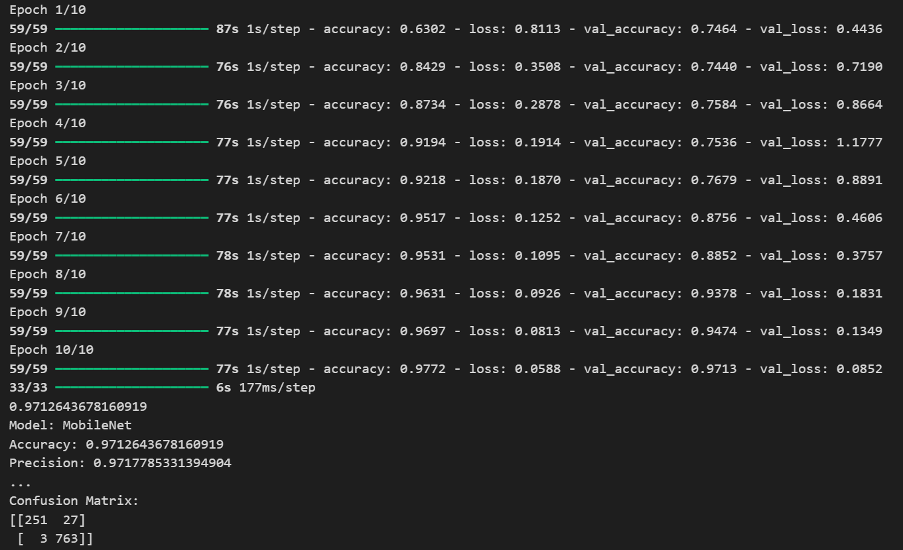
Model Accuracy

Slide 22
CONCLUSION
Accurate Detection: The project successfully demonstrates the application of deep learning in detecting pneumonia from chest X-ray images with high accuracy and efficiency.
User-Centric Design: A user-friendly Flask-based interface ensures easy access and usability for medical professionals and researchers.
Scalable Solution: The model and application can be further developed and integrated into real-time medical systems, enhancing diagnostic capabilities.

